Slide 1

Magnetic
Tape

Slide 2

Contents
What’s
magnetic tape
The uses of
magnetic tape
Physical properties
LTO
(Linear Tape-Open)
How does
It work?
The future,
Comparison

Slide 3
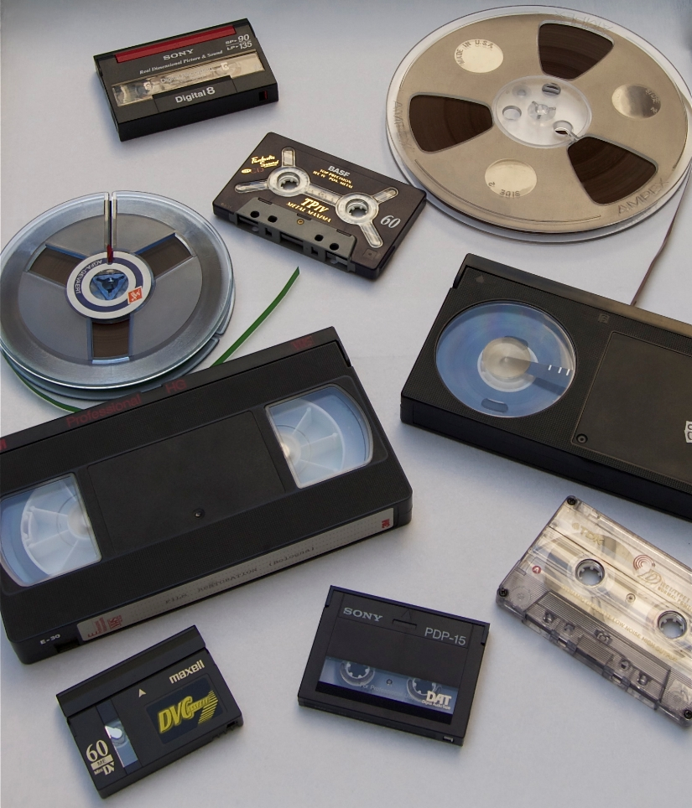
What’s
MAGNETIC TAPE
Consists of a thin ribbon of plastic, one side of which is coated with a material that can be magnetized to record a binary data.
Data can be recover later by computer system.
Usually cartridge type.
Serves as a primary means of:
Backup.
A method of transferring data between system.
A cost effective way to store data that does not have to be accessed immediately.

Slide 4
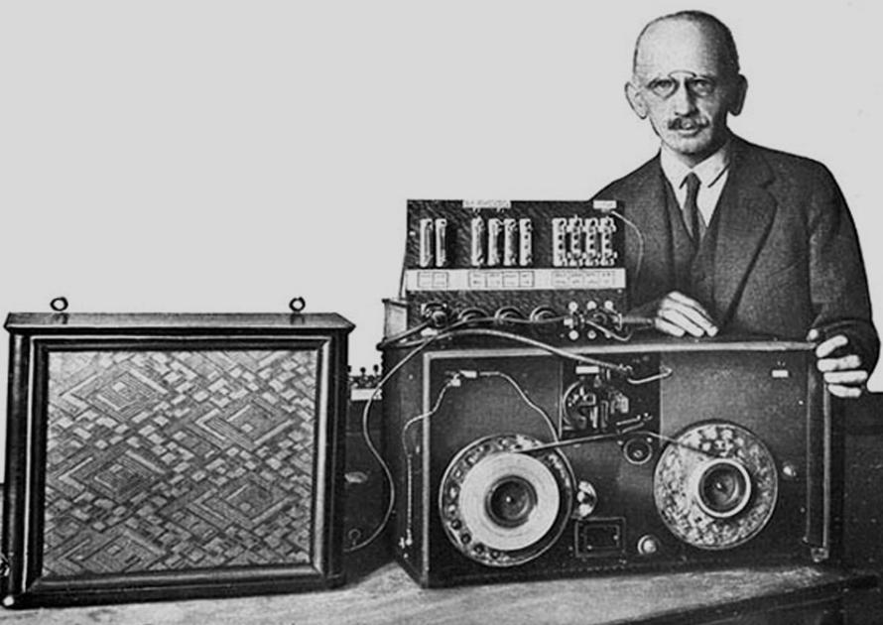
The
ORIGIN & EVOLUTION
The first magnetophone for magnetic recording was invented by Fritz Pfleumer.
With the Germans being at the frontlines in tactical activities and military upgrade for an impending World War II. The magnetic recording was invented in 1928.
Further progressed the idea from 1945 until recording reached the entertainment industry.

Slide 5
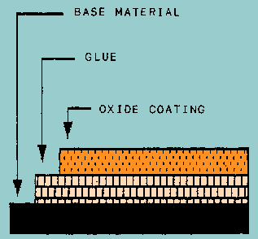
Physical
PROPERTIES
Saturn
It’s a gas giant and has several rings
Magnetic tape contrucsion
Base material
Jupiter
Made of either plastic or metal.
Jupiter is the biggest planet of them
Oxide coating
Neptune
It’s the farthest planet from the Sun
Oxide particles of pure metal in special binders or vapor-plated metal films.
Mars
Despite being red, Mars is cold
Glue
Mercury
It’s the closest planet from the Sun
Organic resin - bond the oxide particles to the base material.
Earth
Earth is the third planet from the Sun

Slide 6
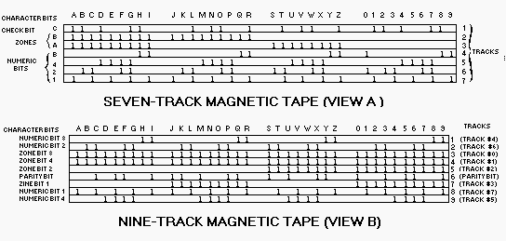
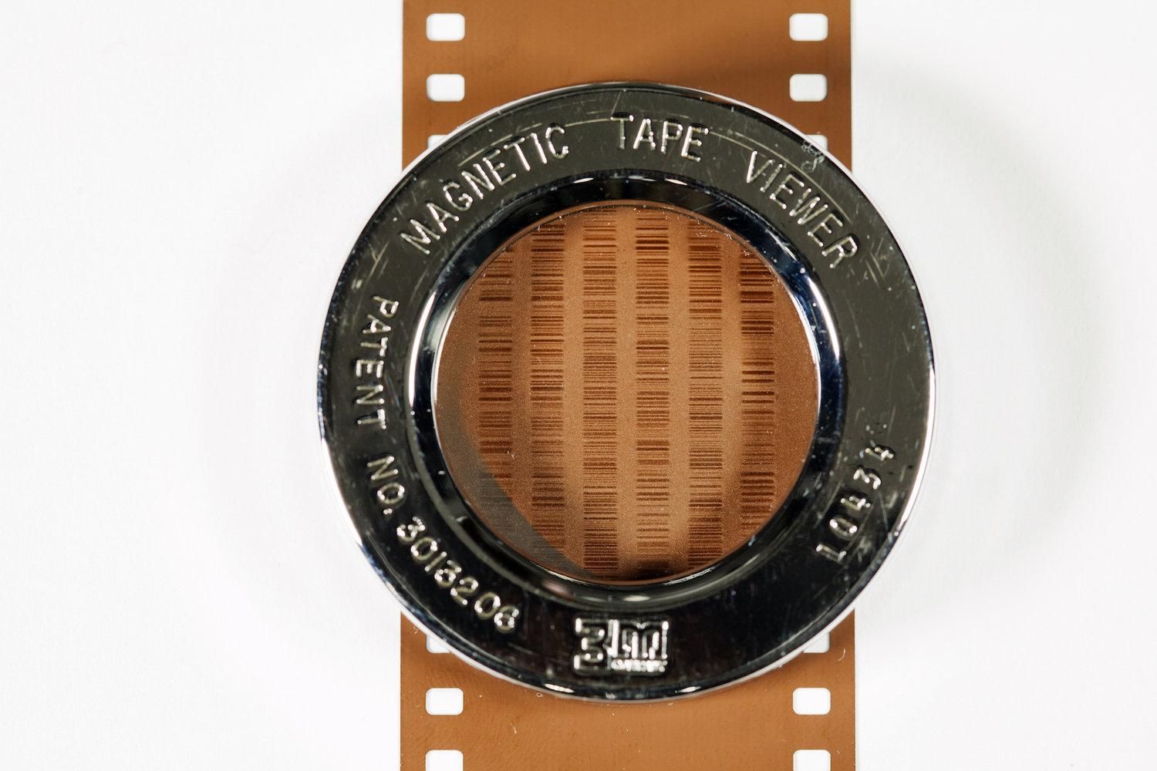
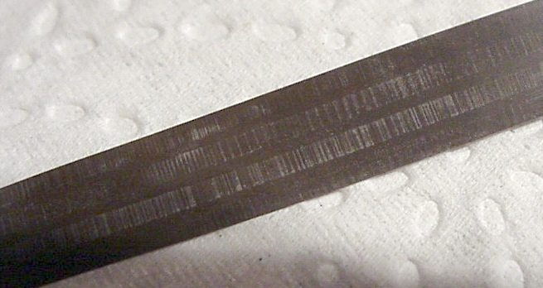
Physical
PROPERTIES
Specifi
-cations
The same reading and recording techniques as disk
Data are structured as parallel tracks running lengthwise
Tape typically used 9 tracks. store 1 byte at a time, parity bit as 9th track
Mars
Jupiter
Despite being red, Mars is actually cold
25%
35%
Jupiter is the biggest planet of them all
Earth
Neptune
Earth is the third planet from the Sun
10%
40%
Neptune is the farthest planet from the Sun

Slide 7
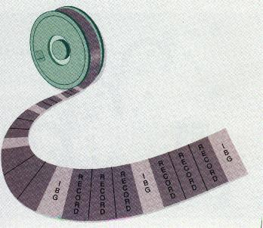
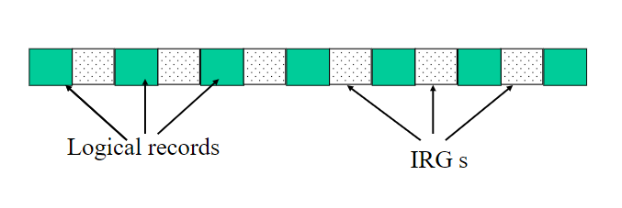
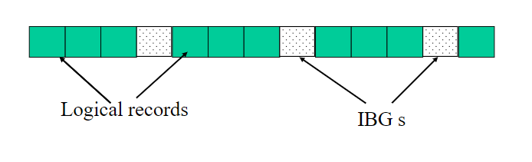
Physical
PROPERTIES
Specifi
-cations
The same reading and recording techniques as disk
Data are structured as parallel tracks running lengthwise
Tape typically used 9 tracks. store 1 byte at a time, parity bit as 9th track
Contiguous blocks - physical record, separated by inter-record gaps
Mars
Jupiter
Despite being red, Mars is actually cold
25%
35%
Jupiter is the biggest planet of them all
Earth
Neptune
Earth is the third planet from the Sun
10%
40%
Neptune is the farthest planet from the Sun

Slide 8

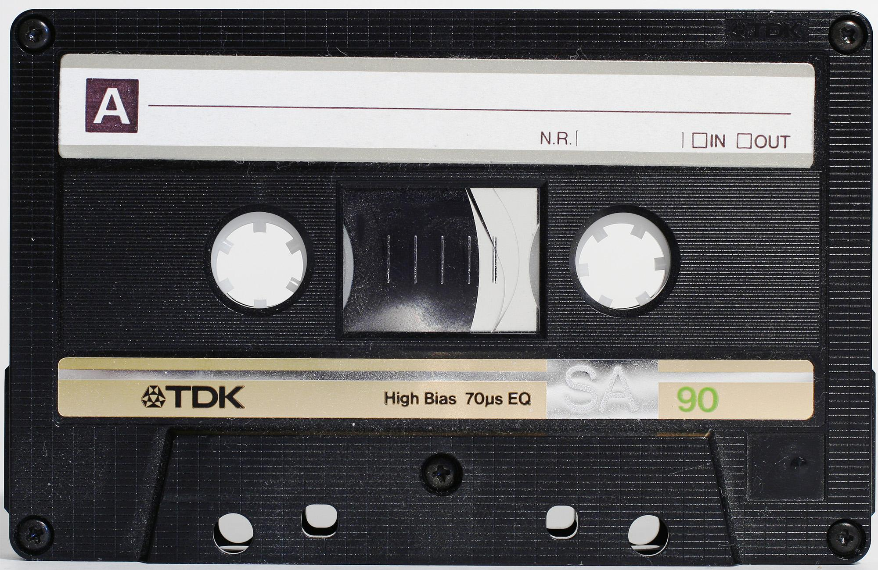
Physical
PROPERTIES
Types of magnetic record
-ing tape
Analog magnetic tape
Digital magnetic tape
Mars
Jupiter
Used to record, store, and reproduce audio and instrumentation type signals
Used to record, store, and reproduce computer programs and data
Despite being red, Mars is actually cold
25%
35%
Jupiter is the biggest planet of them all
Earth
Neptune
Earth is the third planet from the Sun
10%
40%
Neptune is the farthest planet from the Sun

Slide 9
Techniques in
RECORDING
Track 2
Track 1
Track 0
Serpentine reading and writing

Slide 10
Techniques in
RECORDING
Track 3
Track 2
Track 1
Track 0
Block layout for system that reads-writes four tracks simultaneously

Slide 11
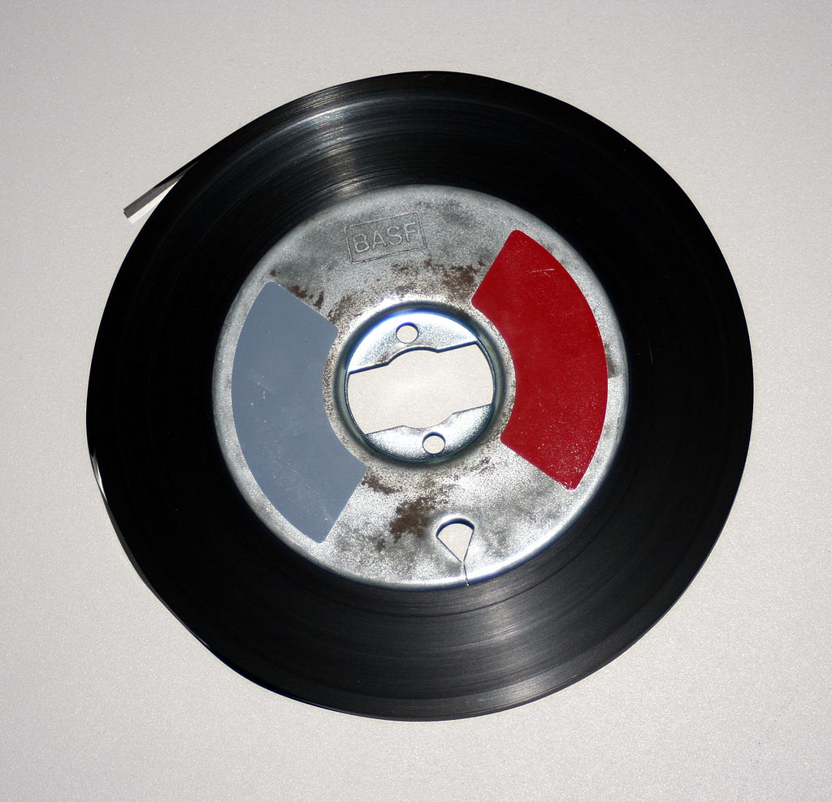
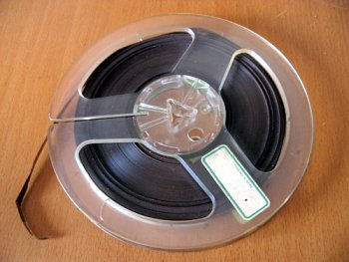
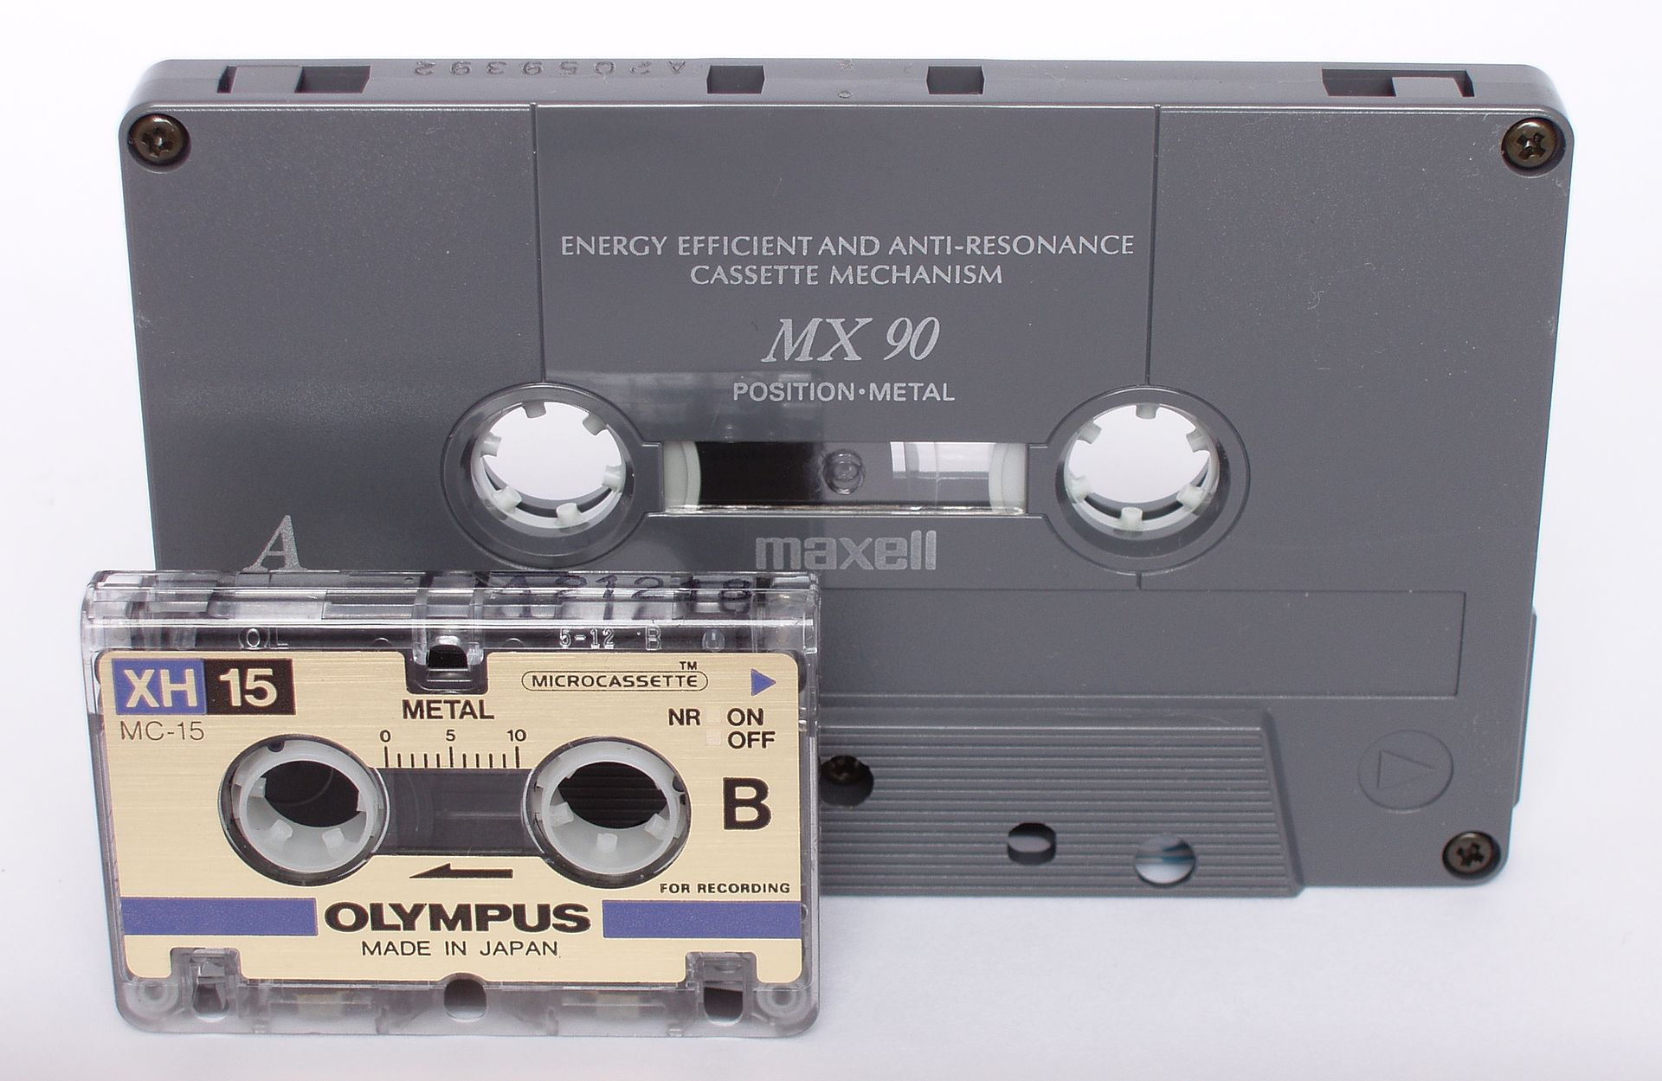
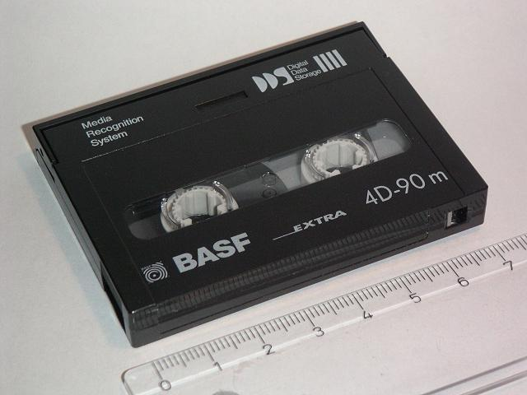
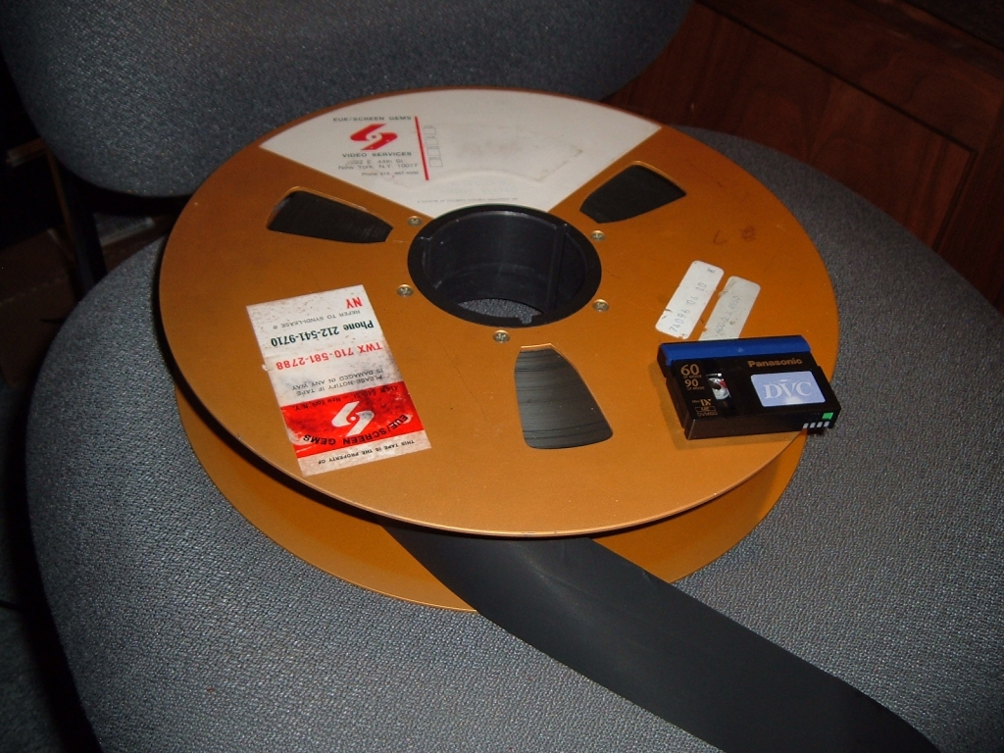
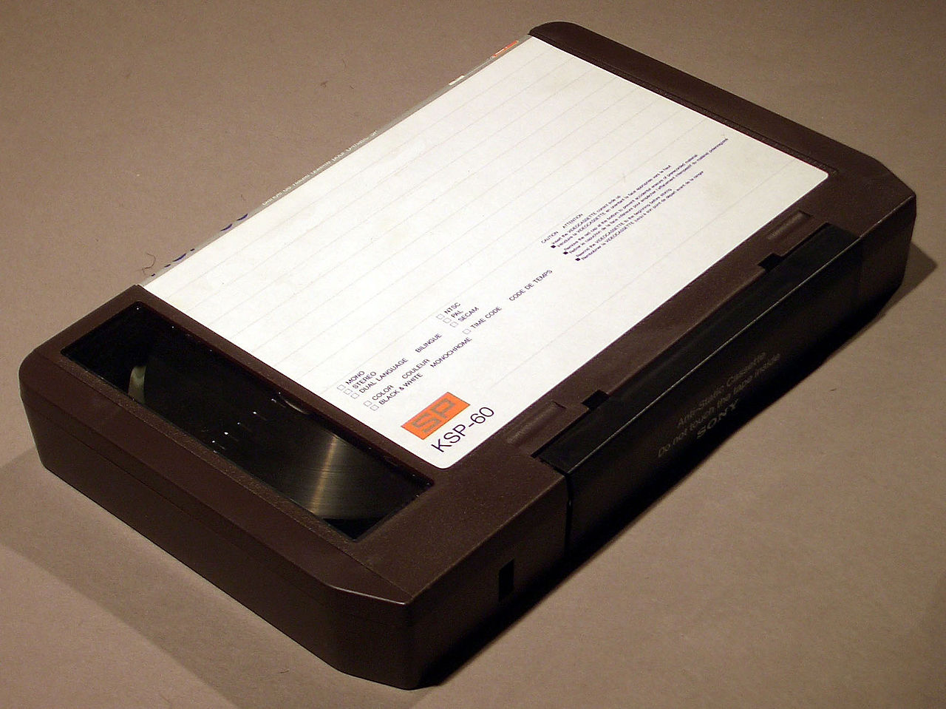
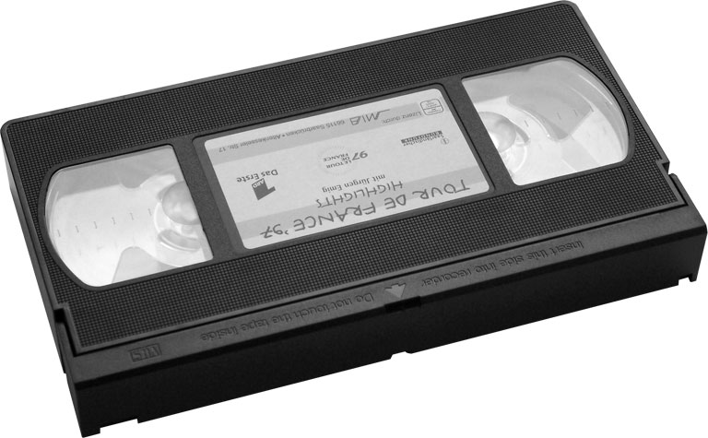
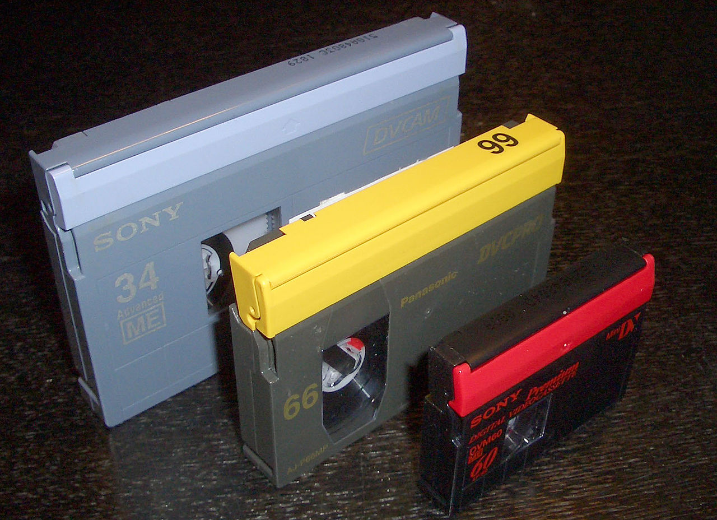
Types and
THE USES
Record audio, video and computer data
Băng ghi âm
Băng ghi âm 1/4 inch
Cassette ghi âm
Cartridge ghi âm số
2 inch Videoband
U-matic Cassette
VHS Cassette
Băng video số DVCAM-L, DVCPRO-M, MiniDV

Slide 12
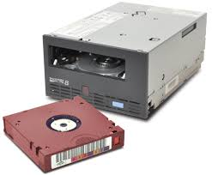

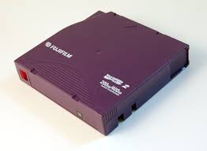
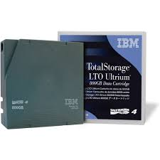

LTO

Slide 13

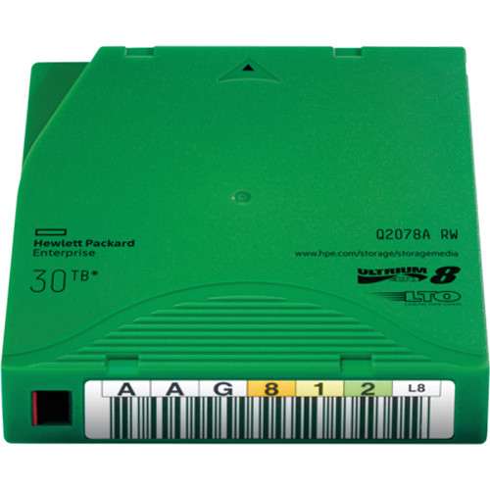
Magnetic tape
POTENTIAL
Need of data storage
Hard drive cannot meet the demand
Outstanding advantages
Technology companies are still researching and developing tape technology

Slide 14
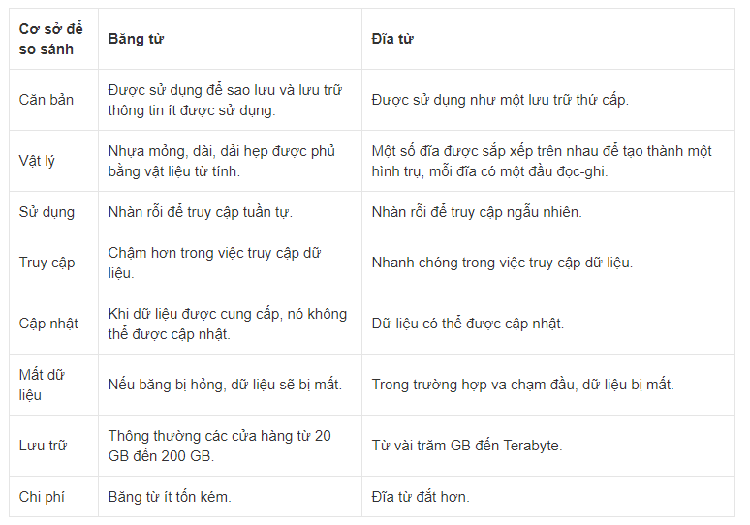
Vs. magnetic disk
COMPARISON

Slide 15
THANK YOU!

